Slide 1
FRAUD DETECTION
PRESENTED BY:​
GUNJAN

Slide 2
CONTENT
Introduction
Data analysis
Data frame
Boxplot For Amount Spend In Category
Histogram For Fraudulent And Non Fraudulent Payment
Data Preprocessing
Transformation Into Categorical Columns
Oversampling with SMOTE
K-Neighbours Classifier
Random Forest Classifier
XGBoost Classifier
Conclusion

Slide 3
Software required
TOOLS USED
1. Anaconda Navigator-1.9.6
2. Jupyter Notebook- 5.7.4
LIBRARY USED
1. Analysing: Numpy, Pandas, Sci-kit Learn
2. Visualization: Matplotlib, Seaborn

Slide 4
IMPORTING THE LIBRARIES
import numpy as np
import pandas as pd
import matplotlib.pyplot as plt
import seaborn as sns
from sklearn.model_selection train_test_split
from sklearn.metric import confusion_matrix, classification_report
from sklearn.metric import roc_curve, auc
import xgboost as xgb
from sklearn.neighbors import KNeighborsClassifier
from sklearn.ensemble import RandomForestClassifier
from sklearn.ensemble import VotingClassifier

Slide 5
Introduction
Fraud detection in bank payments is the practice of using various methods, such as advanced technologies and data analysis, to identify and prevent fraudulent activities related to financial transactions.
Techniques include anomaly detection, machine learning, behavioral analysis, identity verification, and real-time monitoring to swiftly identify and respond to suspicious transactions.

Slide 6
FRAUD DATA
Fraud data will be imbalanced like you see in the plot below and from the count of instances. To balance the dataset one can perform oversample or undersample techniques. Oversampling is increasing the number of the minority class by generating instances from the minority class . Undersampling is reducing the number of instances in the majority class by selecting random points from it to where it is equal with the minority class. Both operations have some risks: Oversample will create copies or similar data points which sometimes would not be helpful for the case of fraud detection because fraudulent transactions may vary. Undersampling means that we lost data points thus information. We will perform an oversampled technique called SMOTE (Synthetic Minority Over-sampling Technique). SMOTE will create new data points from minority class using the neighbour instances so generated samples are not exact copies but they are similar to instances we have

Slide 7
DATA
Step: This feature represents the day from the start of simulation. It has 180 steps so simulation ran for virtually 6 months.
Customer: This feature represents the customer id
zipCodeOrigin: The zip code of origin/source.
Merchant: The merchant's id
zipMerchant: The merchant's zip code
Age: Categorized age
0: <= 18 , 4: 46:55,
1: 19-25, 5: 56:65,
2: 26-35, 6: > 65,
3: 36-45, U: Unknown
Gender: Gender for customer
E : Enterprise,
F: Female,
M: Male,
U: Unknown
Category: Category of the purchase. I won't write all categories here, we'll see them later in the analysis.
Amount: Amount of the purchase
Fraud: Target variable which shows if the transaction fraudulent(1) or benign(0)

Slide 8
Data analysis
data= pd.read_csv("../input/bs140513_032310.csv")
data.head(5)
 | step | customer | age | gender | zipcodeOri | merchant | zipMerchant | category | amount | fraud
0 | 0 | 'C1093826151' | '4' | 'M' | '28007' | 'M348934600' | '28007' | 'es_transportation' | 4.55 | 0
1 | 0 | 'C352968107' | '2' | 'M' | '28007' | 'M348934600' | '28007' | 'es_transportation' | 39.68 | 0
2 | 0 | 'C2054744914' | '4' | 'F' | '28007' | 'M1823072687' | '28007' | 'es_transportation' | 26.89 | 0
3 | 0 | 'C1760612790' | '3' | 'M' | '28007' | 'M348934600' | '28007' | 'es_transportation' | 17.25 | 0
4 | 0 | 'C757503768' | '5' | 'M' | '28007' | 'M348934600' | '28007' | 'es_transportation' | 35.72 | 0

Slide 9
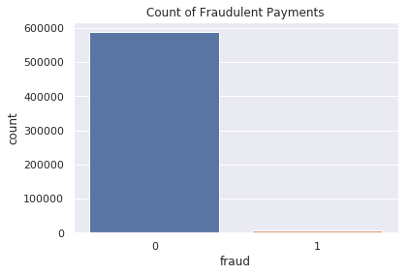
DATA FRAME
sns.countplot(x="fraud",data=data)
plt.title("Count of Fraudulent Payments")
plt.show()
print("Number of normal examples: ",df_non_fraud.fraud.count())
print("Number of fradulent examples: ",df_fraud.fraud.count())
Number of normal examples: 587443
Number of fraudulent examples: 7200

Slide 10
Choosing category
 | Fraudulent | Non-Fraudulent | Percent(%)
'es_transportation' | NaN | 26.958187 | 0.000000
'es_food' | NaN | 37.070405 | 0.000000
'es_hyper' | 169.255429 | 40.037145 | 4.591669
'es_barsandrestaurants' | 164.092667 | 41.145997 | 1.882944
'es_contents' | NaN | 44.547571 | 0.000000
'es_wellnessandbeauty' | 229.422535 | 57.320219 | 4.759380
'es_fashion' | 247.008190 | 62.347674 | 1.797335
'es_leisure' | 300.286878 | 73.230400 | 94.989980
'es_otherservices' | 316.469605 | 75.685497 | 25.000000
'es_sportsandtoys' | 345.366811 | 88.502738 | 49.525237
'es_tech' | 415.274114 | 99.924638 | 6.666667
'es_health' | 407.031338 | 103.737228 | 10.512614
'es_hotelservices' | 421.823339 | 106.548545 | 31.422018
'es_home' | 457.484834 | 113.338409 | 15.206445
'es_travel' | 2660.802872 | 669.025533 | 79.395604

Slide 11
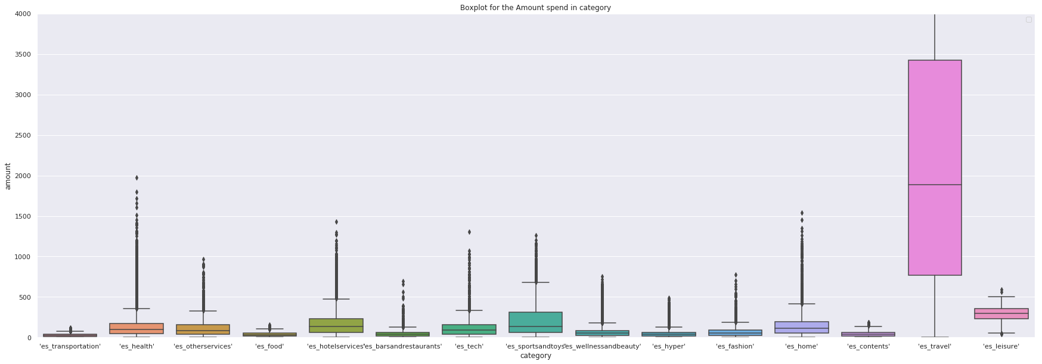
BOXPLOT FOR AMOUNT SPEND IN CATEGORY
plt.figure(figsize=(30,10))
sns.boxplot(x=data.category,y=data.amount)
plt.title("Boxplot for the Amount spend in category")
plt.ylim(0,4000)
plt.legend()
plt.show()

Slide 12
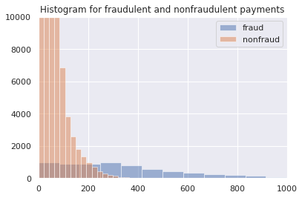
HISTOGRAM FOR FRAUDULENT AND NON FRAUDULENT PAYMENT

Slide 13
DATA PREPROCESSING
Collect historical transaction data, which includes features like transaction amount, time, location, transaction type, and any other relevant information. Preprocess the data by cleaning, transforming, and engineering features as needed. Also, balance the dataset if fraud cases are significantly lower in number compared to legitimate cases (imbalanced dataset).
We will transform categorical features into numerical values. It is usually better to turn these type of categorical values into dummies because they have no relation in size(i.e. customer1 is not greater than customer2) but since they are too many (over 500k customers and merchants) the features will grow 10^5 in size and it will take forever to train..

Slide 14
TRANSFORMATION INTO CATEGORICAL COLUMNS
# categorical values ==> numeric values
data_reduced[col_categorical] = data_reduced[col_categorical].apply(lambda x: x.cat.codes)
data_reduced.head(5)
 | step | customer | age | gender | merchant | category | amount | fraud
0 | 0 | 210 | 4 | 2 | 30 | 12 | 4.55 | 0
1 | 0 | 2753 | 2 | 2 | 30 | 12 | 39.68 | 0
2 | 0 | 2285 | 4 | 1 | 18 | 12 | 26.89 | 0
3 | 0 | 1650 | 3 | 2 | 30 | 12 | 17.25 | 0
4 | 0 | 3585 | 5 | 2 | 30 | 12 | 35.72 | 0

Slide 15
Oversampling with SMOTE
In a fraud detection project, it's common to encounter imbalanced datasets where the majority of transactions are non-fraudulent (normal) and a small fraction are fraudulent. This imbalance can lead to challenges when training machine learning models as they might struggle to effectively learn the patterns associated with the minority class (fraudulent transactions). One way to address this issue is by using oversampling techniques such as Synthetic Minority Over-sampling Technique (SMOTE).
# The base score should be better than predicting always non-fraduelent
print("Base accuracy score we must beat is: ",
df_non_fraud.fraud.count()/np.add(df_non_fraud.fraud.count(),df_fraud.fraud.count()) * 100).
Base accuracy score we must beat is : 98.7891894800746

Slide 16
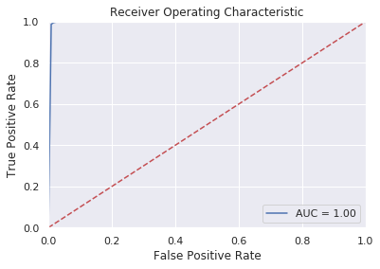
K-Neighbours Classifier
Confusion Matrix of K-Nearest Neighbours:
[[172041 4192]
[ 376 175857]]

Slide 17
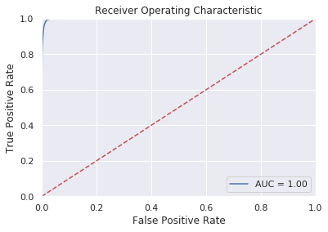
Random Forest Classifier
Confusion Matrix of Random Forest Classifier:
[ [171433 4800]
[ 583 175650] ]

Slide 18

XGBoost Classifier
Confusion Matrix of XGBoost:
[[175727 506]
[ 310 175923]]

Slide 19
CONCLUSION
Incorporating machine learning into bank payment fraud detection proves instrumental in fortifying financial security. By analyzing patterns and anomalies, it swiftly identifies and prevents fraudulent activities, safeguarding both institutions and customers from substantial losses. This technological approach bolsters confidence in digital transactions, ensures seamless financial operations, and sets a robust precedent for combating evolving fraud tactics in the banking sector.

Slide 20
THANK YOU

